Slide 1
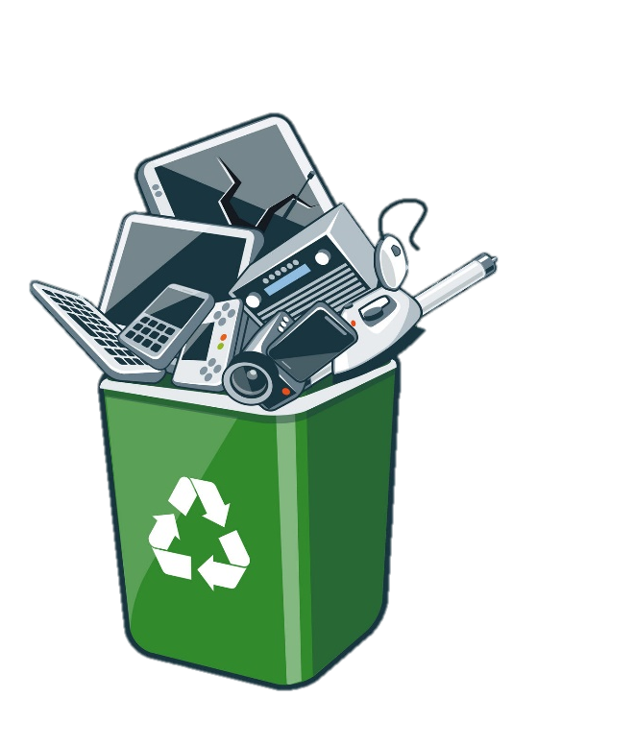
Recycling guide
E-WASTE: A NEW ENVIROMENTAL CHALLENGE
Gabriele Dominelli I4AA
Gabriel Mendonça I4AC
SAMT 13.12.2018
PDI MPT 4A

Slide 2

Summary
E-Waste in general
Hard Disks
What are
How recycling works
Mother Boards
What are
How recycling works
Personal Consideration
Sources

Slide 3
E-Waste in general

Slide 4
Hard Disks – What are

Slide 5
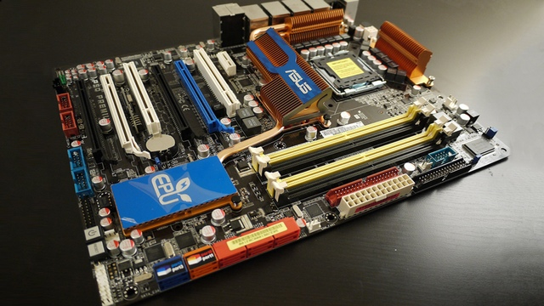
Mother Boards– What are
Essentials

Slide 6
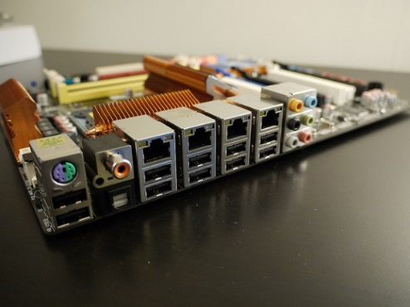
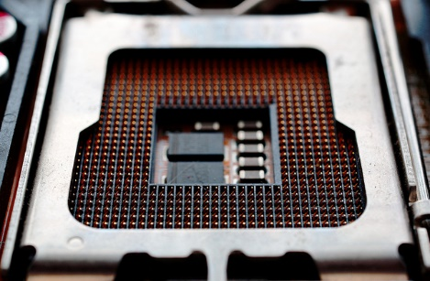
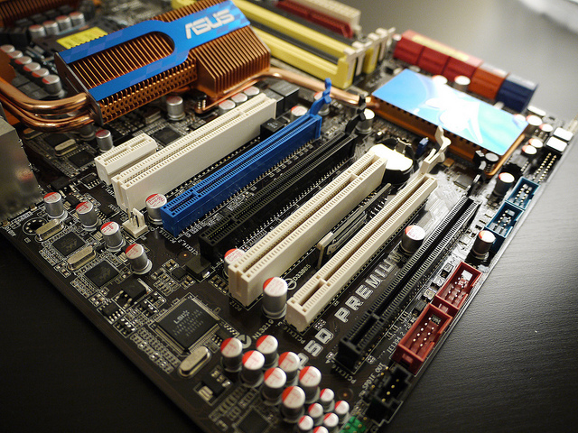
Mother Boards– What are
Slots
Processor
DDR
input

Slide 7

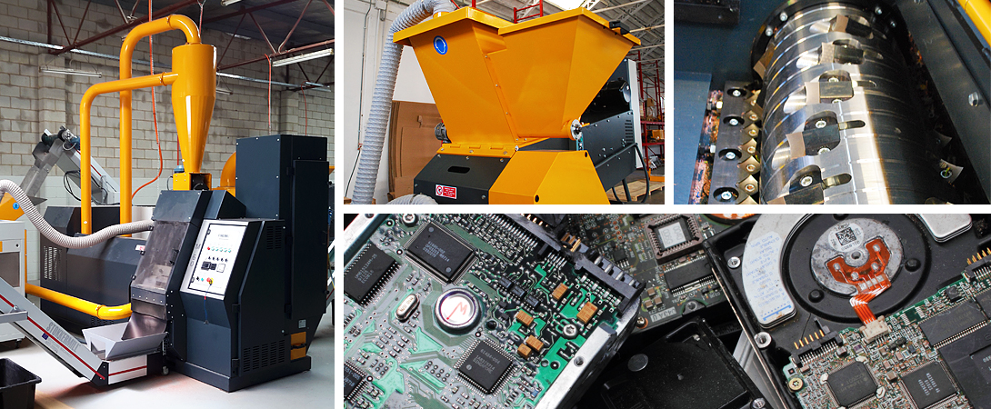
Mother Boards– How recycling works
Acid
Machinery

Slide 8
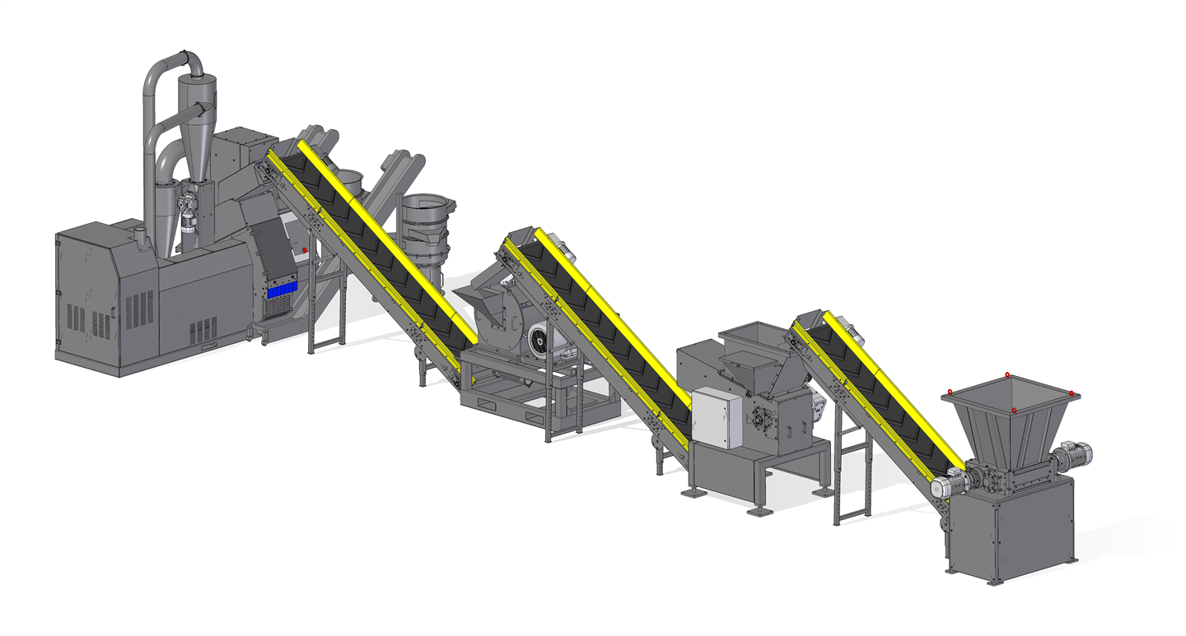
Mother Boards– How recycling works

